Slide 1

By Mehrunisa Naik
Pharmaceutical Sales prediction across multiple stores

Slide 2
Points for Discussion
Instructions
The task is divided into the following objectives
Exploration of customer purchasing behavior
Prediction of store sales
Machine learning approach
Deep Learning approach
Serving predictions on a web interface

Slide 3
Data Summary
Id - an Id that represents a (Store, Date) duple within the test set
Store - a unique Id for each store
Sales - the turnover for any given day (this is what you are predicting)
Customers - the number of customers on a given day
Open - an indicator for whether the store was open: 0 = closed, 1 = open
StateHoliday - indicates a state holiday. Normally all stores, with few exceptions, are
closed on state holidays. Note that all schools are closed on public holidays and
weekends. a = public holiday, b = Easter holiday, c = Christmas, 0 = None
SchoolHoliday - indicates if the (Store, Date) was affected by the closure of public
schools
StoreType - differentiates between 4 different store models: a, b, c, d
Assortment - describes an assortment level: a = basic, b = extra, c = extended. Read
more about assortment here

Slide 4
Data Summary
CompetitionDistance - distance in meters to the nearest competitor store
CompetitionOpenSince[Month/Year] - gives the approximate year and month of the
time the nearest competitor was opened
Promo - indicates whether a store is running a promo on that day
Promo2 - Promo2 is a continuing and consecutive promotion for some stores: 0 =
store is not participating, 1 = store is participating
Promo2Since[Year/Week] - describes the year and calendar week when the store
started participating in Promo2
PromoInterval - describes the consecutive intervals Promo2 is started, naming the
months the promotion is started anew. E.g. "Feb,May,Aug,Nov" means each round
starts in February, May, August, November of any given year for that store

Slide 5
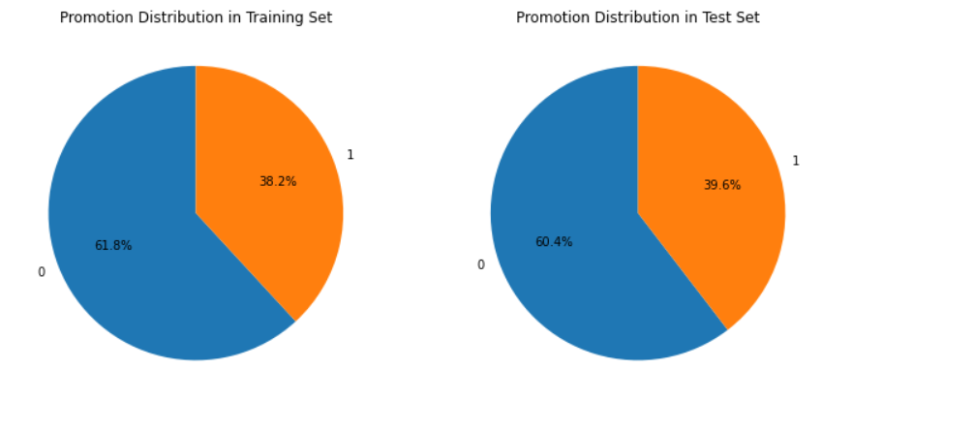
Exploration of customer purchasing behavior
Distribution in both training and test sets

Slide 6
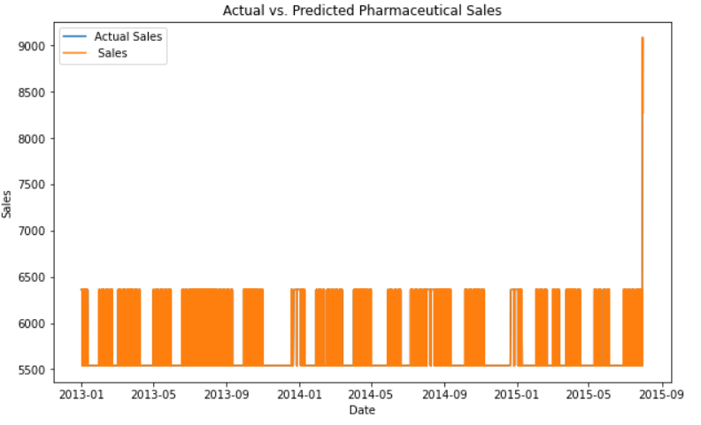
Predicted Pharmaceutical Sales
Predicted pharmaceutical sale using sales and date columns

Slide 7
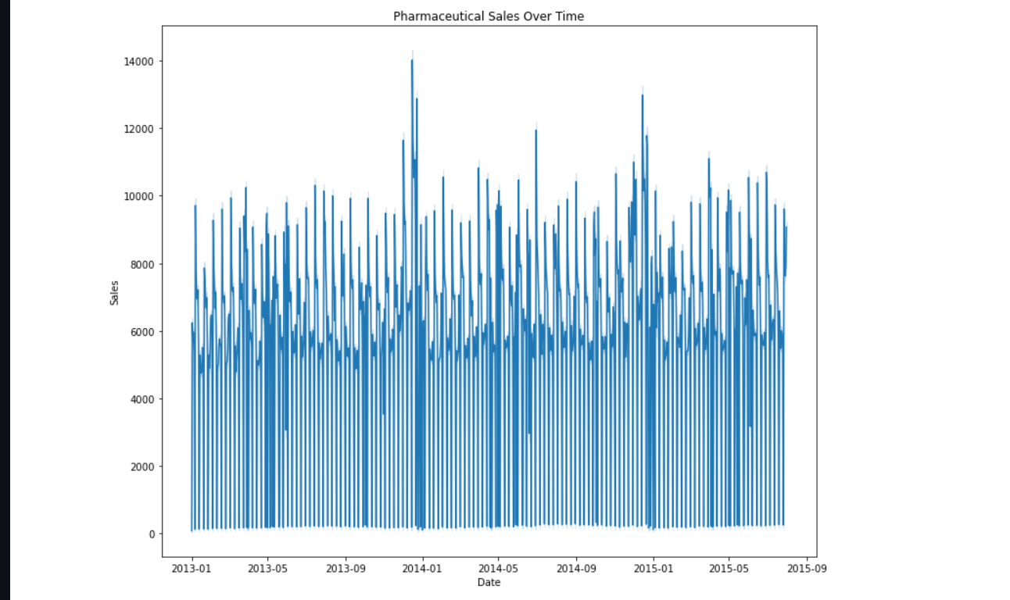
Seasonal (Christmas, Easter etc.) purchase behaviors
Pharmaceutical Sales Over Time

Slide 8
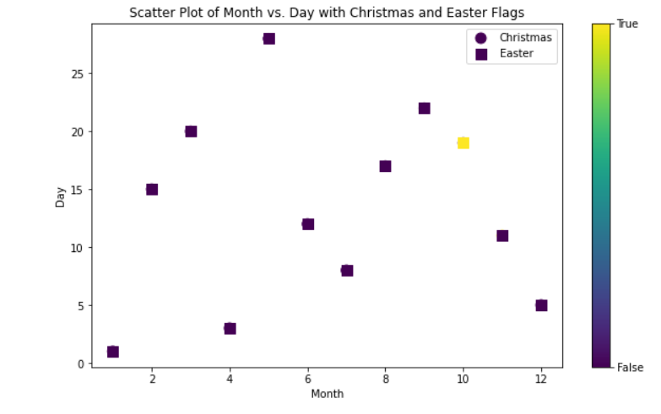
Scatter Plot of Month vs. Day with Christmas and Easter Flags

Slide 9
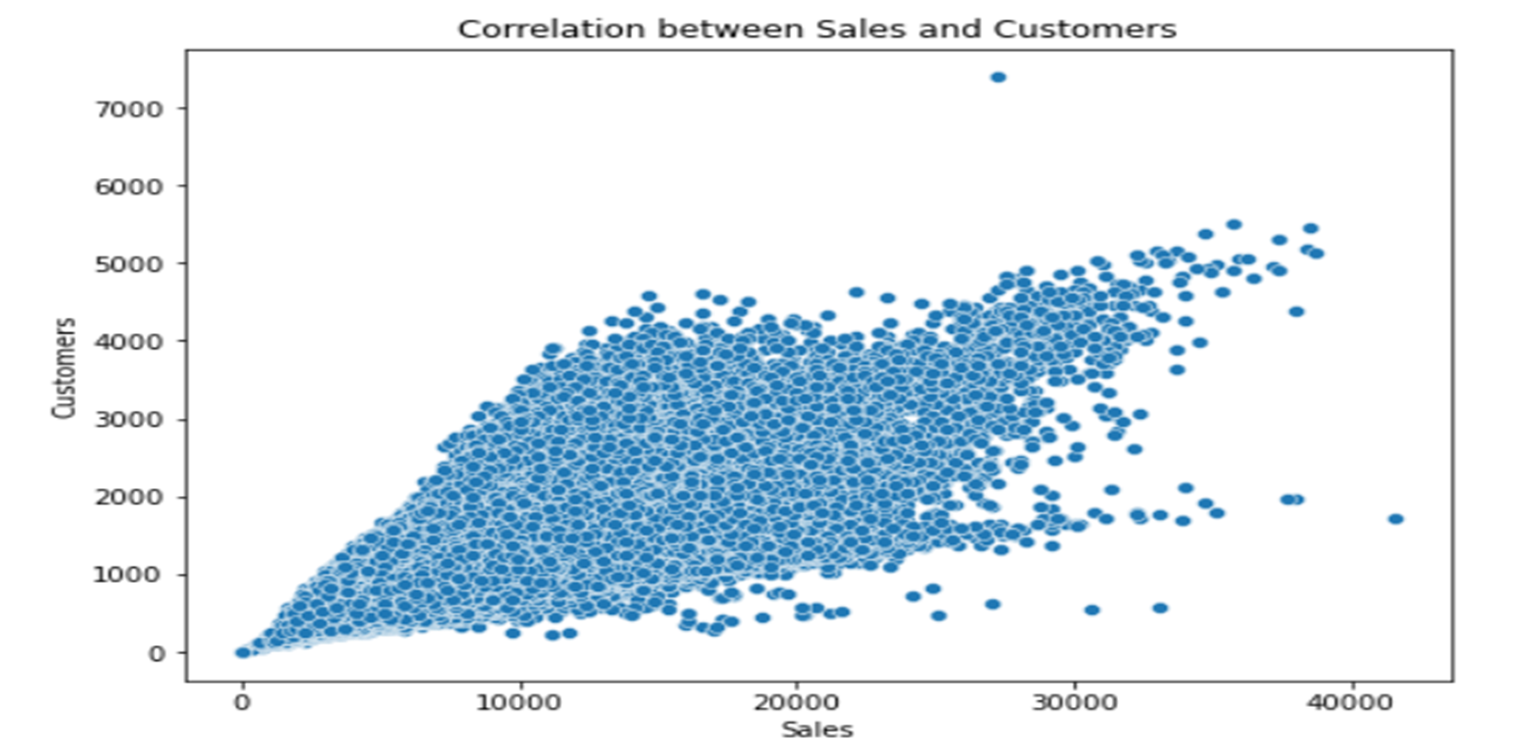
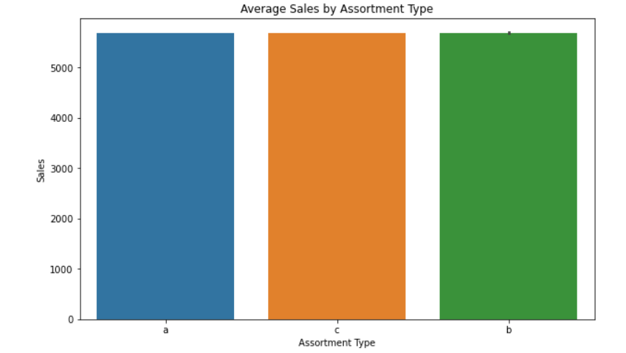
Average Sales by Assortment Type
Correlation between Sales and Customers

Slide 10
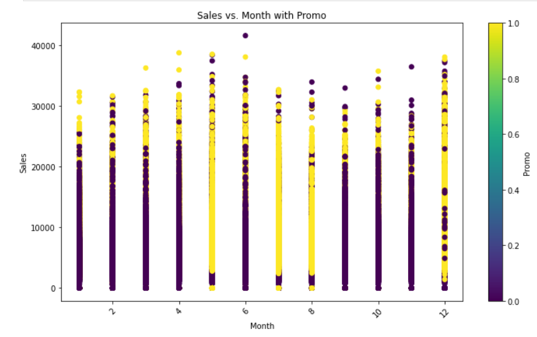
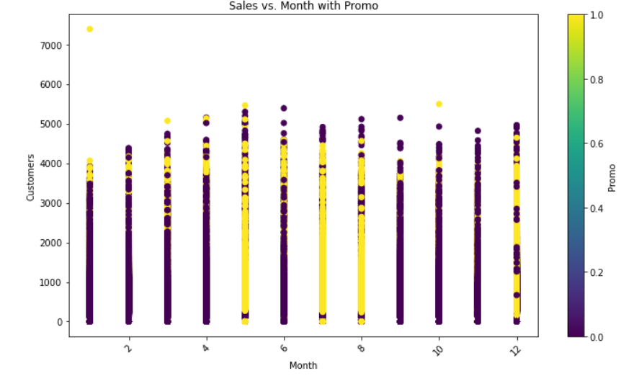
Sales vs. Month with Promo
Month vs. Customer with Promo

Slide 11
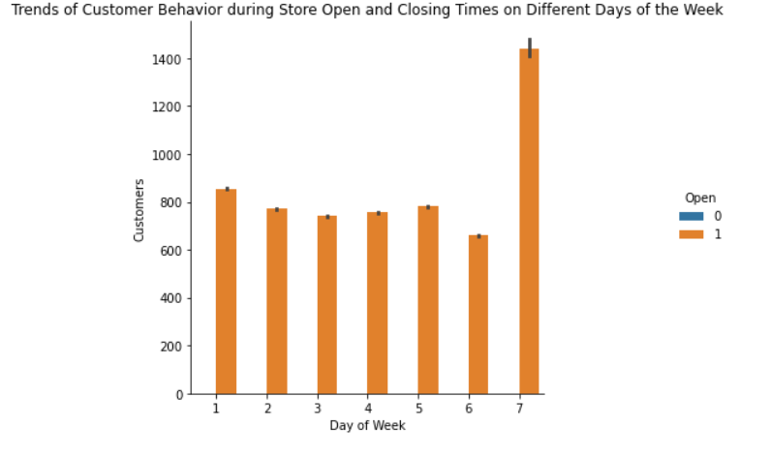
Trends of Customer Behavior during Store Open and Closing Times on Different Days of the Week

Slide 12
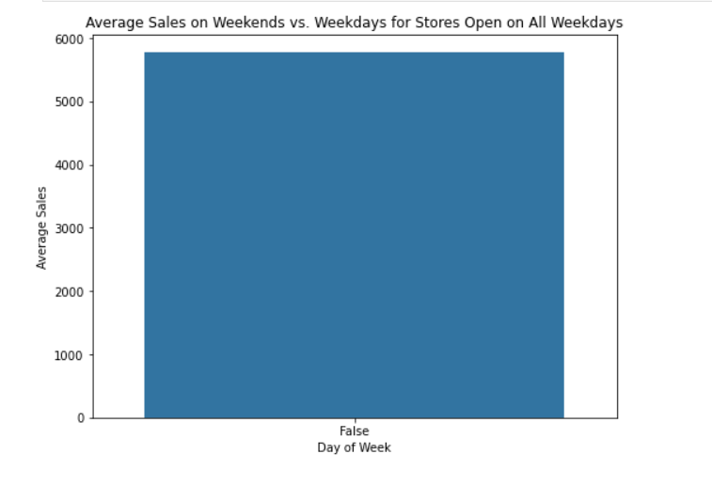
Average Sales on Weekends vs. Weekdays for Stores Open on All Weekdays

Slide 13
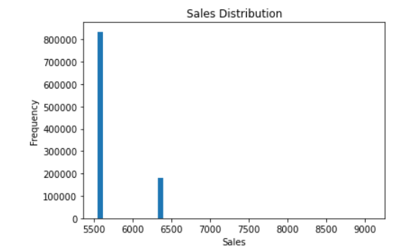
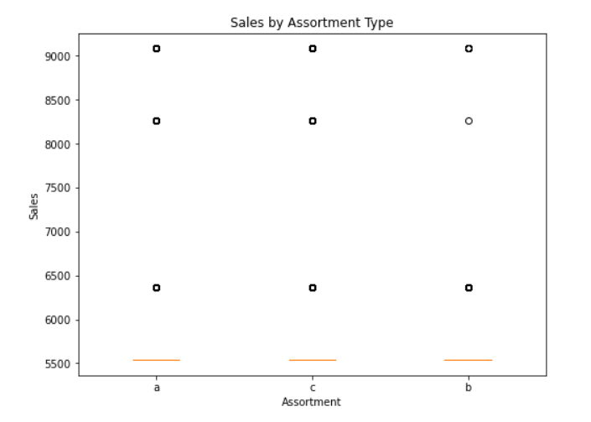
Sales Distribution
Check how the assortment type affects sales
Sales by Assortment Type

Slide 14
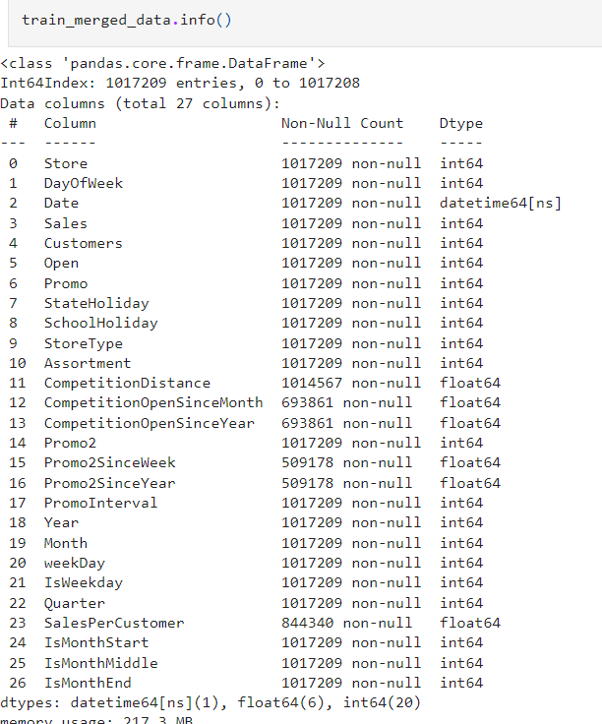
Preprocessing
it is important to process the data into a format where it can be fed to a machine learning model. This typically means converting all non-numeric columns to numeric, handling NaN values and generating new features from already existing features. In our case, you have a few datetime columns to preprocess. you can extract the following from them
Merge csv file test data and store data use this columns and merge data successfully.
This train_merge_data ,csv file use and merge useful columns .

Slide 15
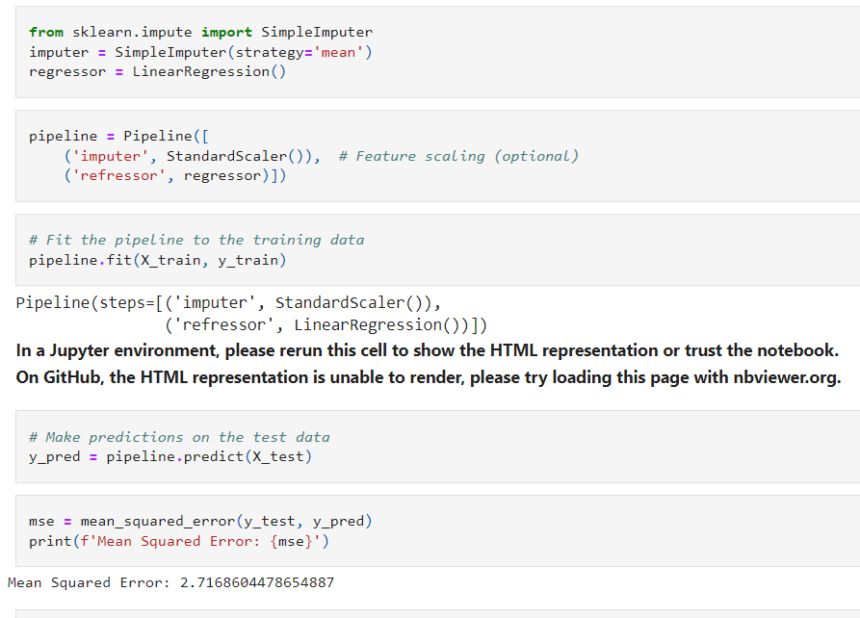
Building models with sklearn pipelines

Slide 16
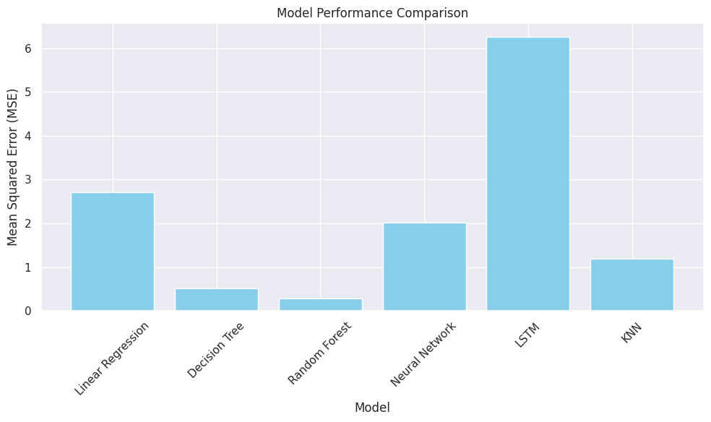
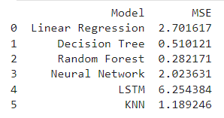
Models

Slide 17
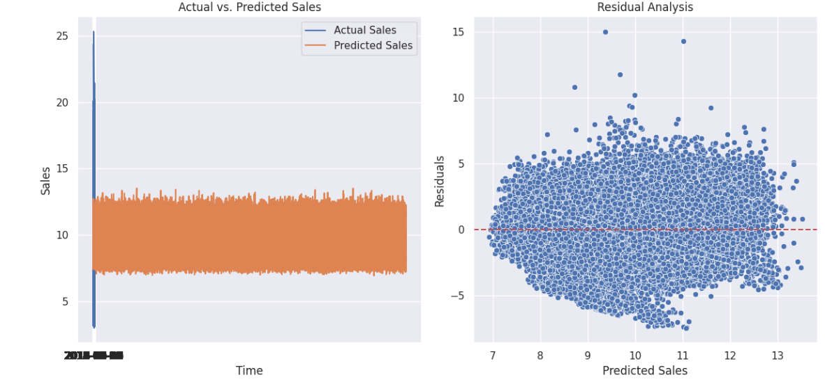
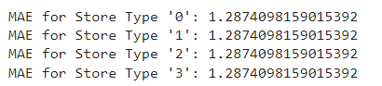
Post Prediction analysis

Slide 18
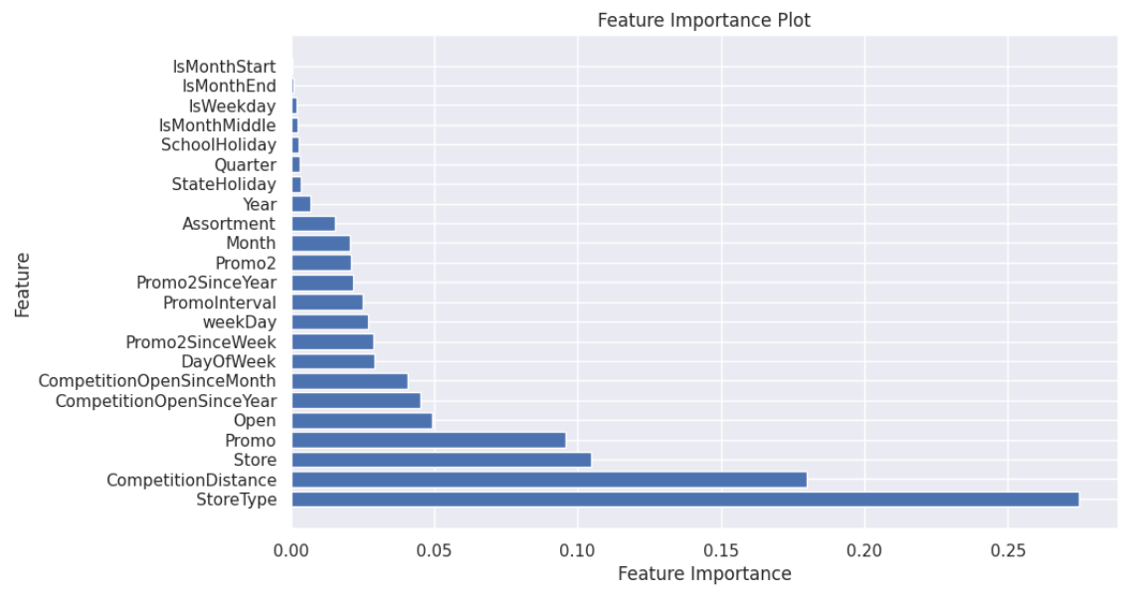
Feature Importance Plot

Slide 19
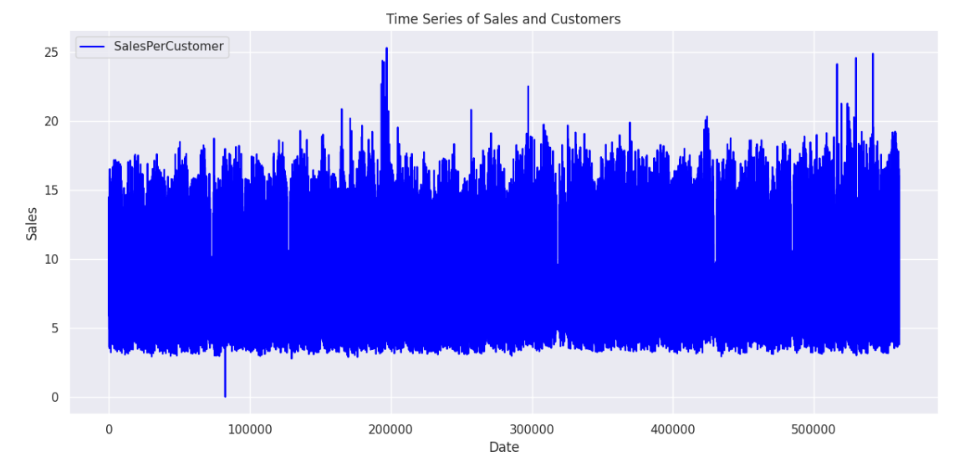
TIME SERIES ANALYSIS

Slide 20
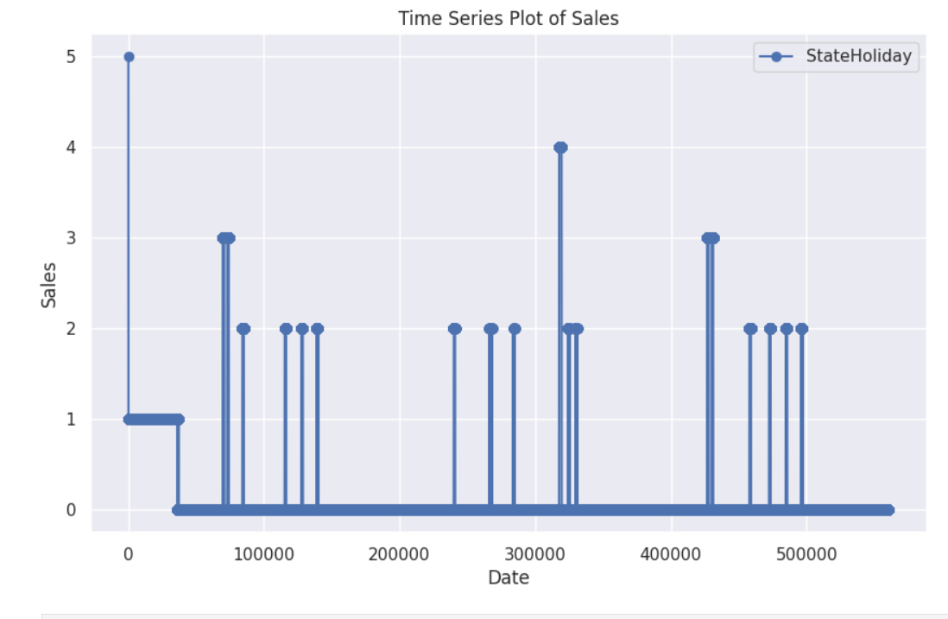
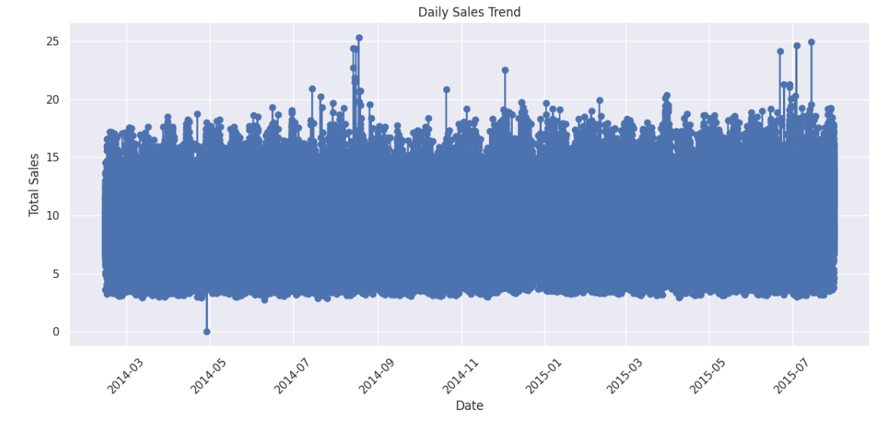

Slide 21
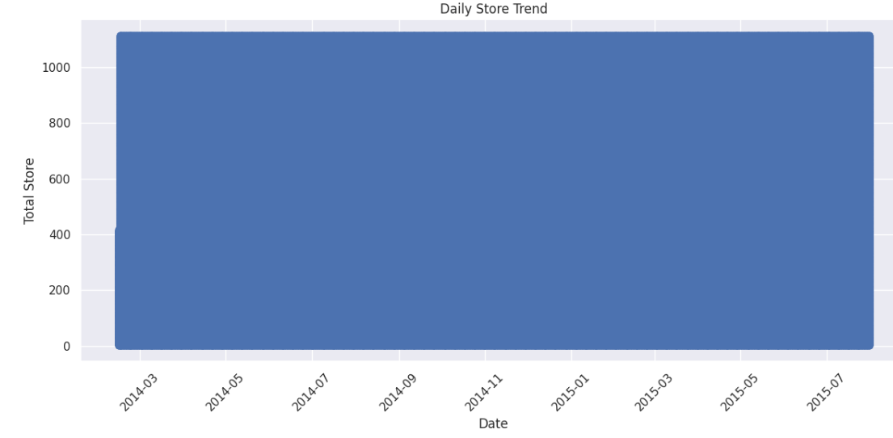
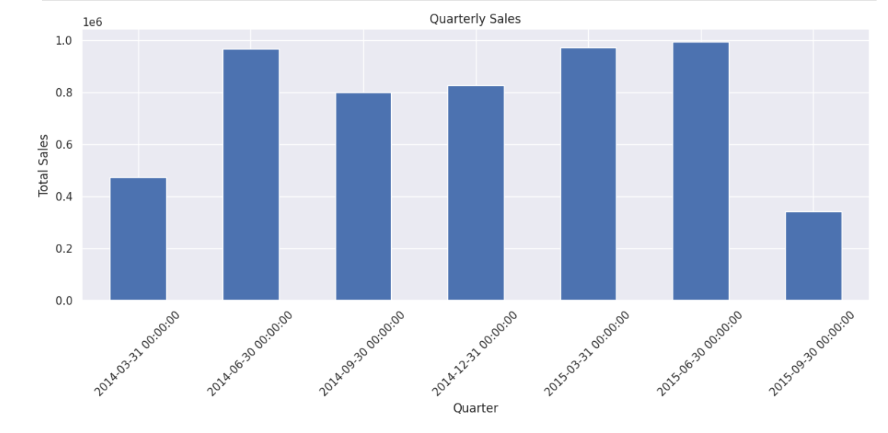
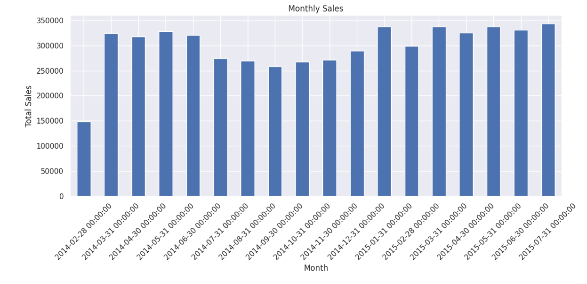
Trend Analysis

Slide 22
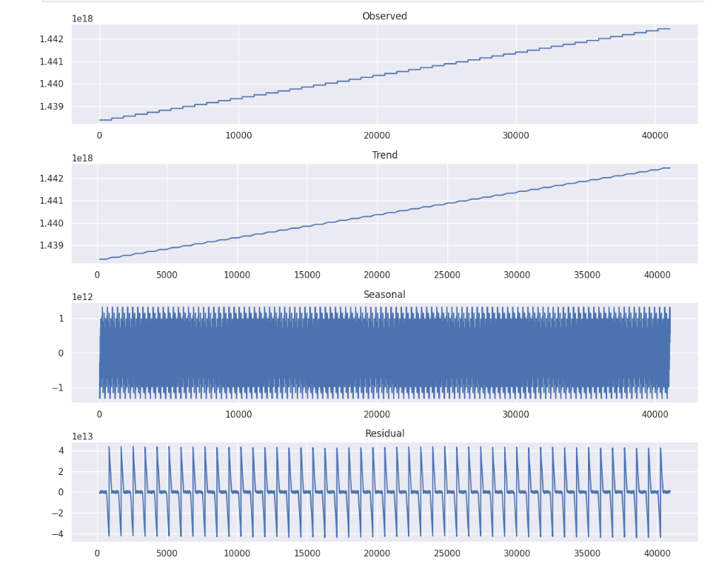
Trend Analysis

Slide 23
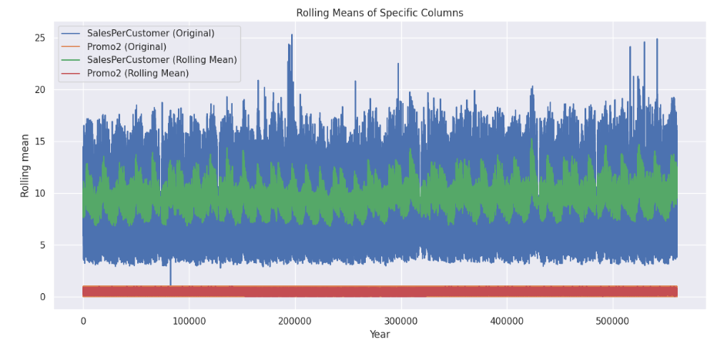
Rolling Means of Specific Columns
Analyzing the rolling mean of sales within the range of 7-14 while considering promotional activity levels at a constant range of 0 to 1 can provide insights into how promotions may impact sales trends over a medium-term period.
This analysis helps assess whether the presence or absence of promotions within this range is associated with specific patterns or fluctuations in sales behavior.

Slide 24
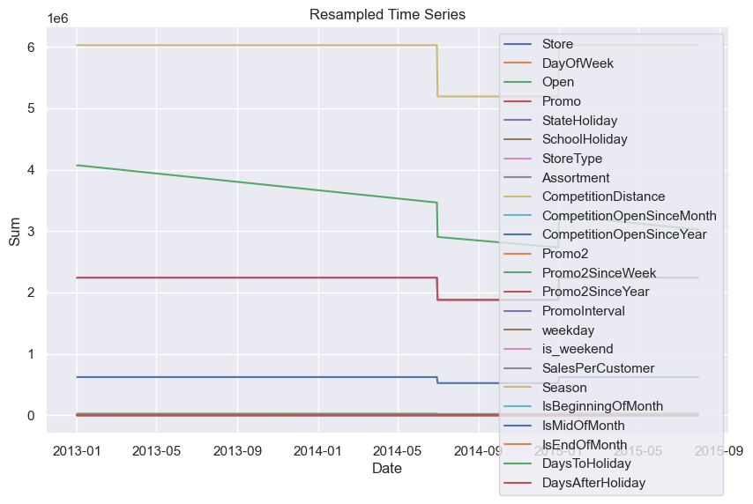
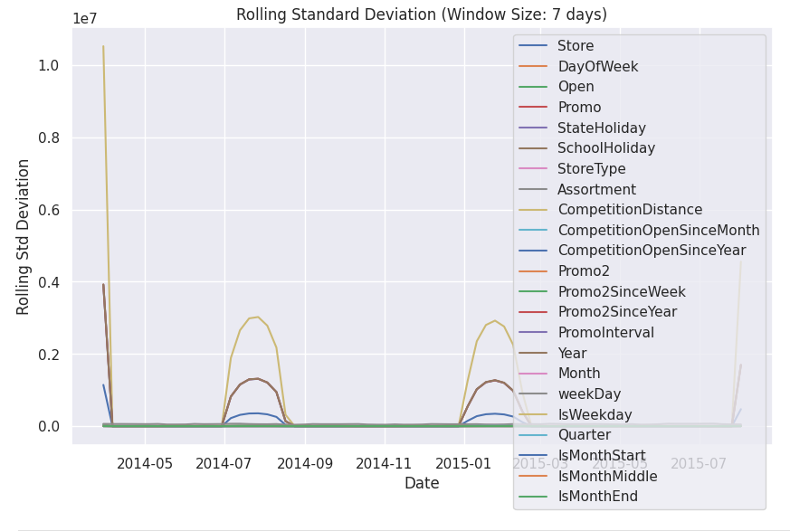
Both in Resampled Time series and Rolling Standard Deviation Plot we can see there is high fluctuation in the mid-year 2014

Slide 25
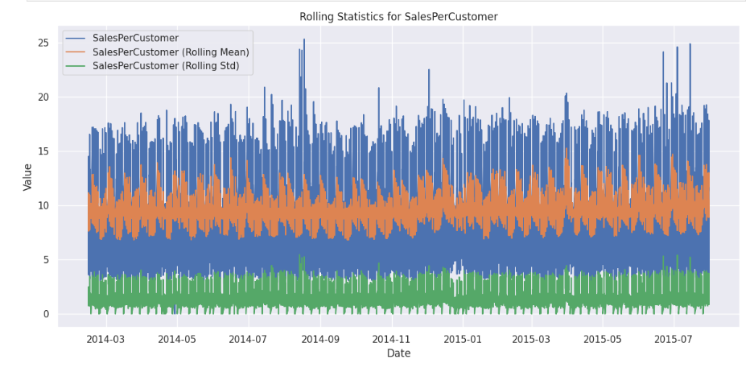

Slide 26
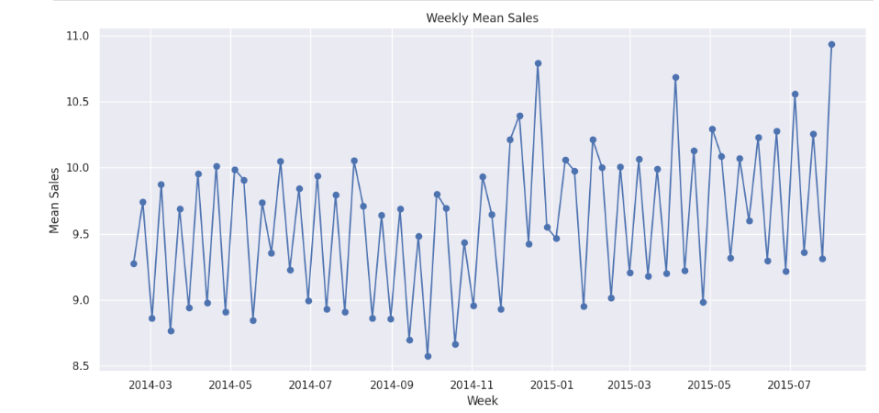
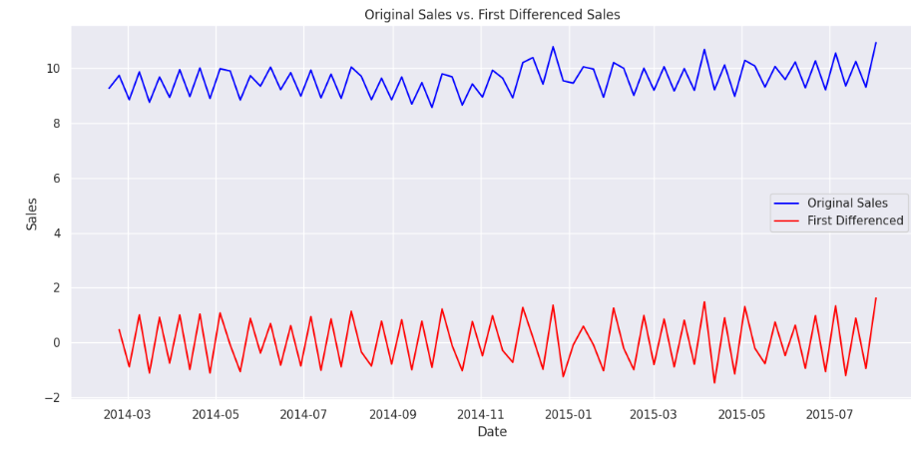
First Differenced Sales represents the sales data after applying a differencing operation, specifically taking the difference between each data point and the previous one.
The differencing process have reduced the overall variability or patterns in the data, making it appear more stable or stationary.

Slide 27
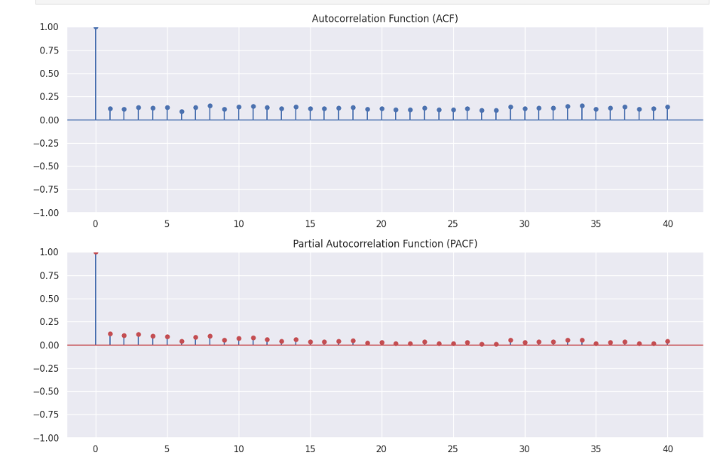
A fluctuating ACF pattern with both falling and rising values typically signifies seasonality within the data. It suggests regular, repeating cycles at specific time intervals.
On the other hand, when PACF values are notably lower than ACF values, it indicates that the direct correlation between the current observation and its past lags is relatively weak compared to the influence of other lags or variables.

Slide 28
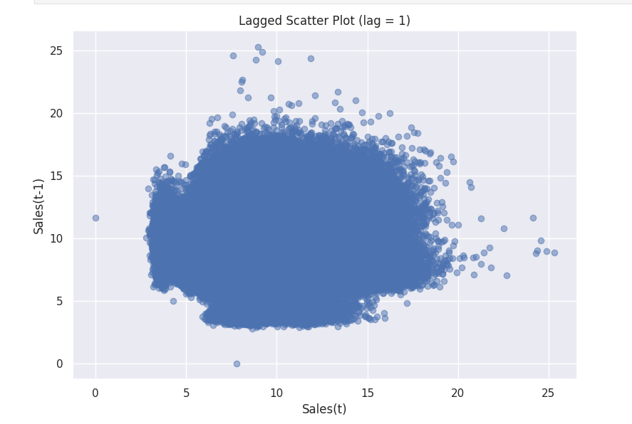
An increase in the current time period, denoted as 't,' leading to an increase in the future time period 't+lag' indicates a positive correlation or dependency between the two time points.
In other words, as time progresses from 't' to 't+lag,' any changes, improvements, or variations occurring at 't' are expected to have a corresponding impact on the future time period 't+lag.

Slide 29
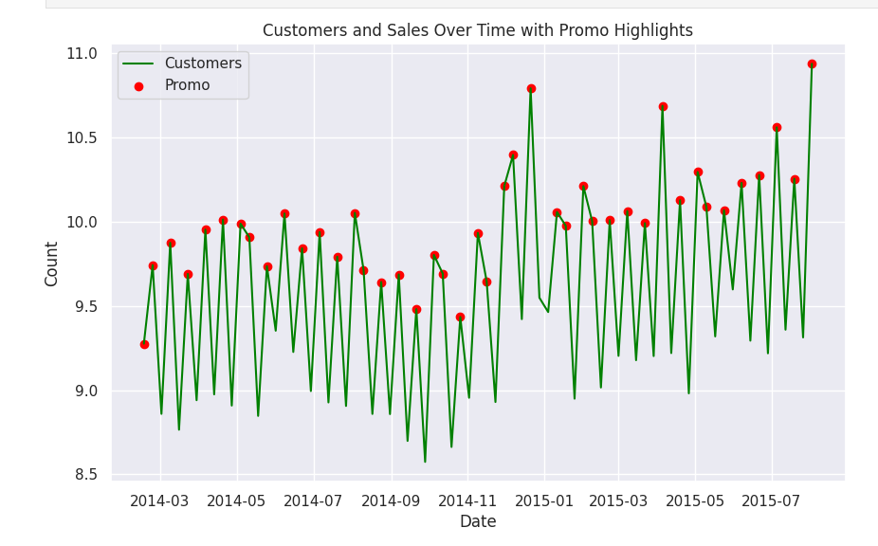

Slide 30
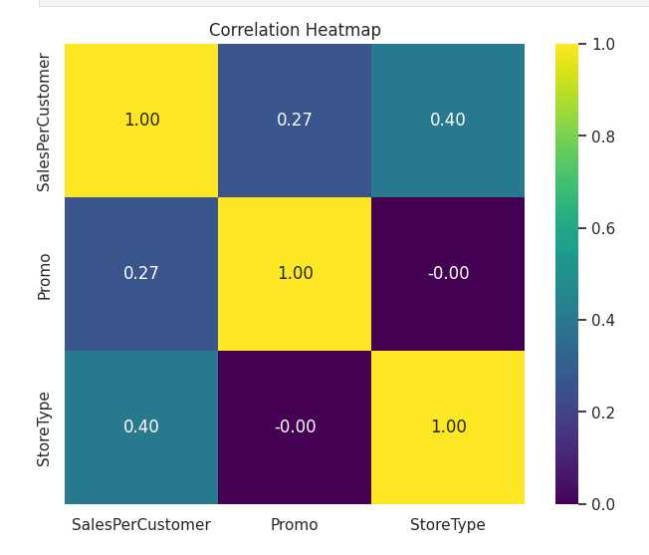

Slide 31
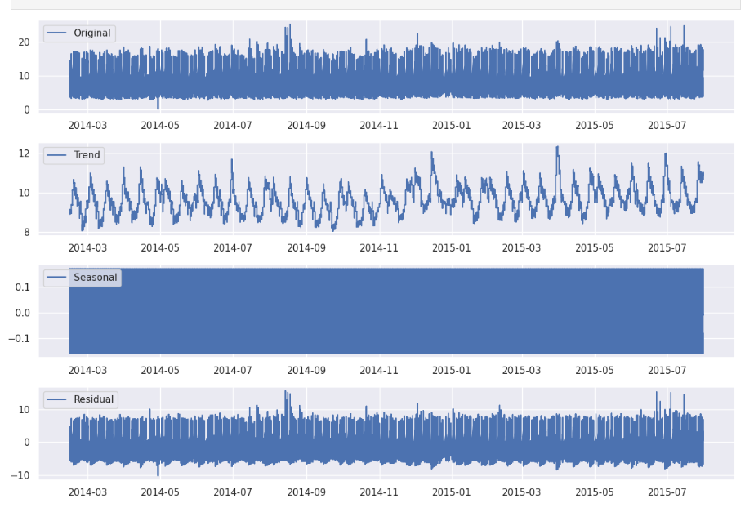
Plot the decomposed components

Slide 32
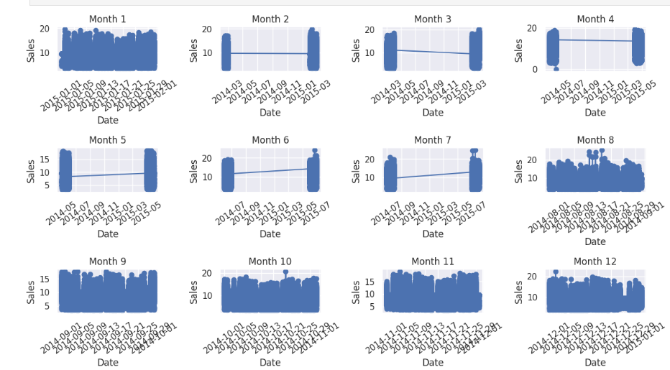
Iterate through each month and create subplots

Slide 33
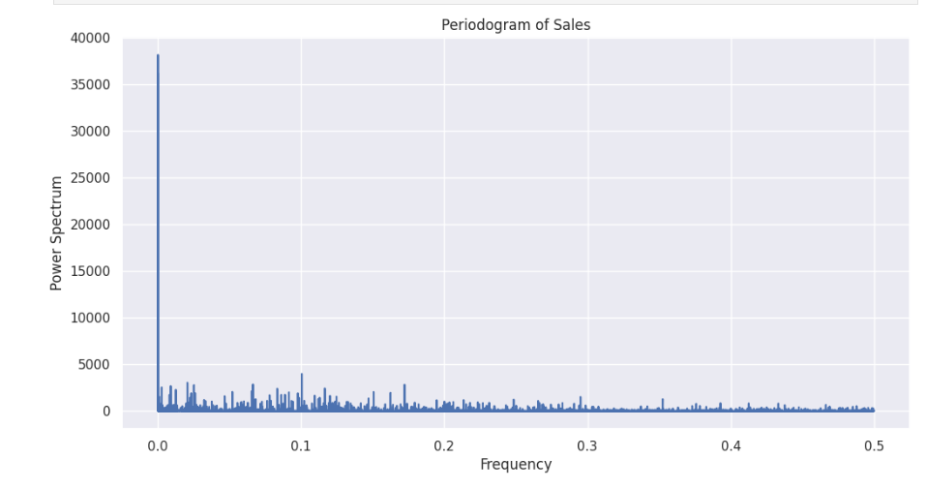
A periodogram showing high spectral power near 0 and decreasing power as it approaches 1 suggests that the sales data is characterized by a dominant low-frequency component, possibly indicating long-term trends or seasonality

Slide 34
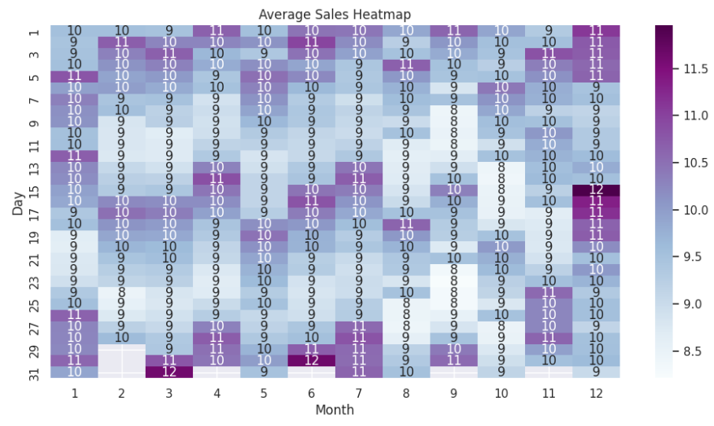

Slide 35
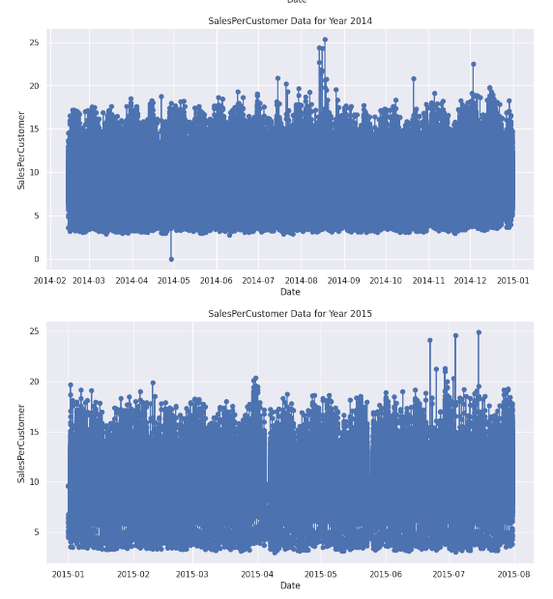
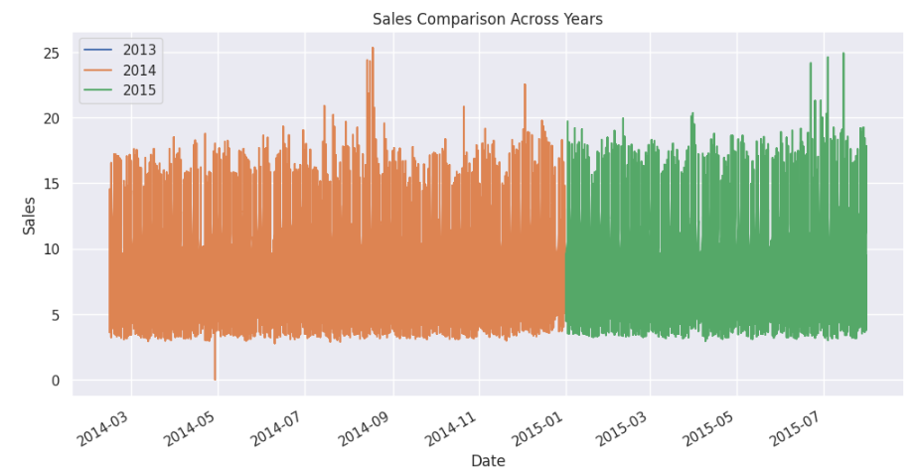
The sales data exhibits low variation, with a substantial increase in sales in the year 2013, followed by consistent sales levels in the subsequent years of 2014 and 2015.

Slide 36
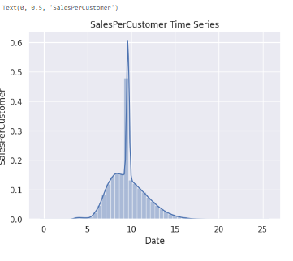
Stationarity Check

Slide 37
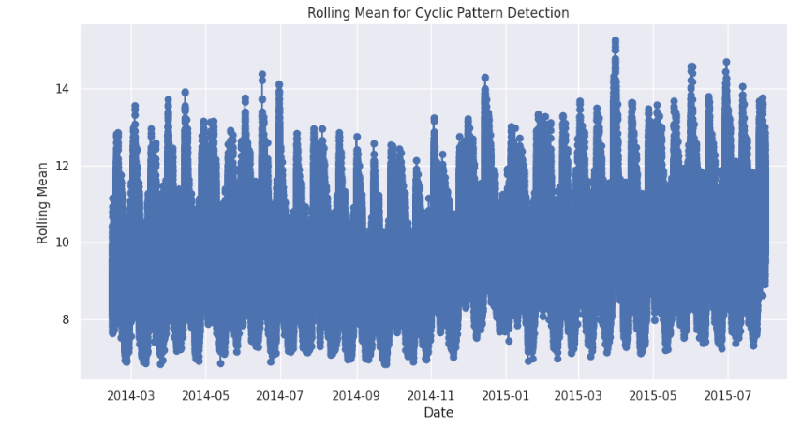
Cyclicality:
Cyclicality refers to the presence of long-term periodic patterns in a time series that are not tied to a fixed frequency like seasonality. These cycles usually last longer than a year and are not as regular as seasonal patterns. Cycles can be caused by economic, political, or social factors that influence the data over time. Unlike seasonality, cyclic patterns are not as predictable and can vary in amplitude and duration

Slide 38
ARIMA (AutoRegressive Integrated Moving Average):
ARIMA models are versatile and can handle both trend and seasonality in data.
They consist of three main components: AutoRegressive (AR) terms, Integrated (I) terms for differencing, and Moving Average (MA) terms.
Model selection involves determining the order of these components (p, d, q) based on ACF and PACF plots.
You can use functions like auto_arima from the pmdarima library for automatic ARIMA order selection.
SARIMA (Seasonal ARIMA)

Slide 39
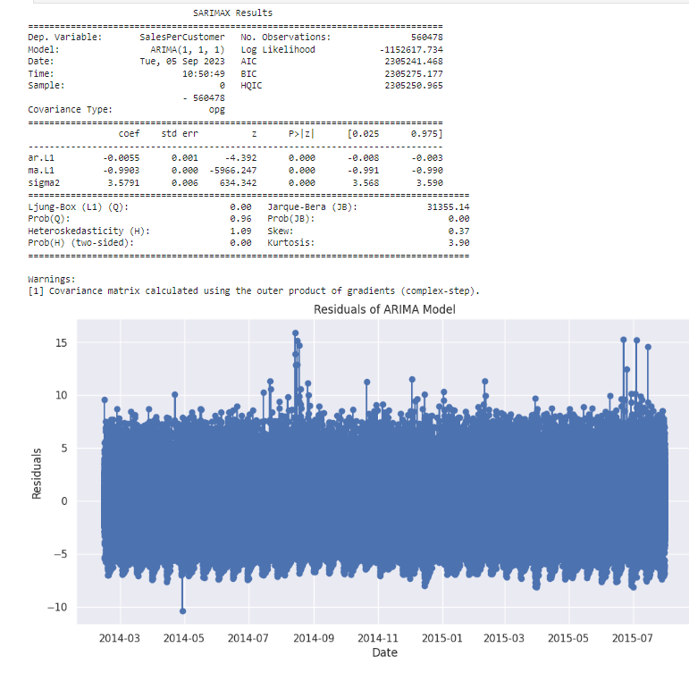

Slide 40
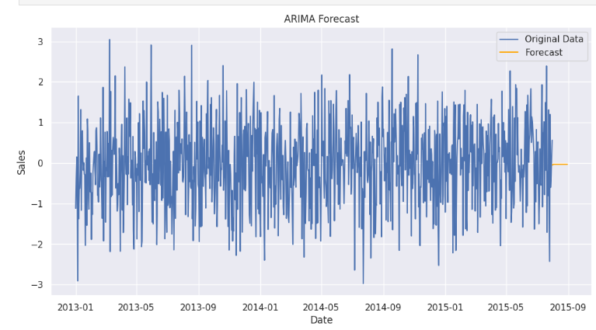
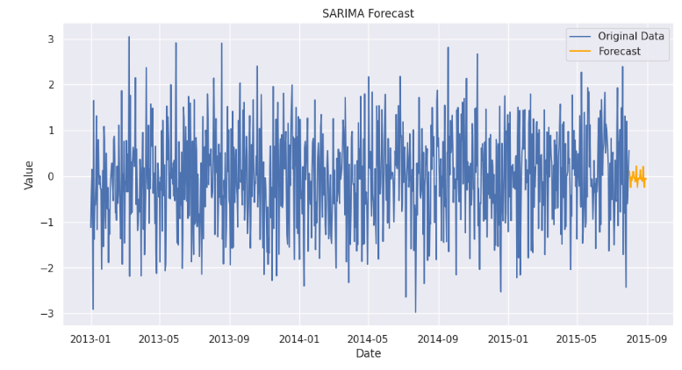
In this stepwise search for the best ARIMA model, various combinations were tested to minimize the AIC (Akaike Information Criterion), which is a measure of a model's goodness of fit. The presented models represent different combinations of autoregressive (AR), differencing (I), and moving average (MA) components, as well as seasonal components (S).
The best-fitting model identified is ARIMA(0,1,0)(1,1,0)[12], which suggests a non-seasonal differencing order of 1, no autoregressive or moving average components, and a seasonal differencing order of 1 with a seasonal component of 12 (indicating seasonality at a 12-month interval).
The results of this best-fitting model show that it has the lowest AIC value (408.305), indicating a good fit to the data. The coefficients and diagnostic statistics are also provided, offering insights into the model's performance and its ability to capture the underlying patterns in the time series data.

Slide 41
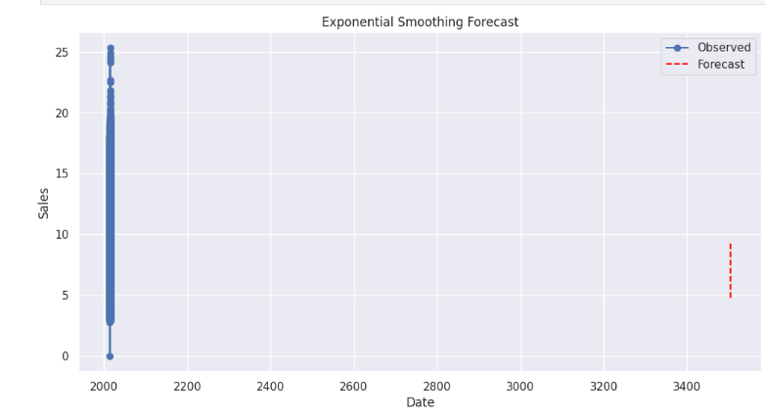
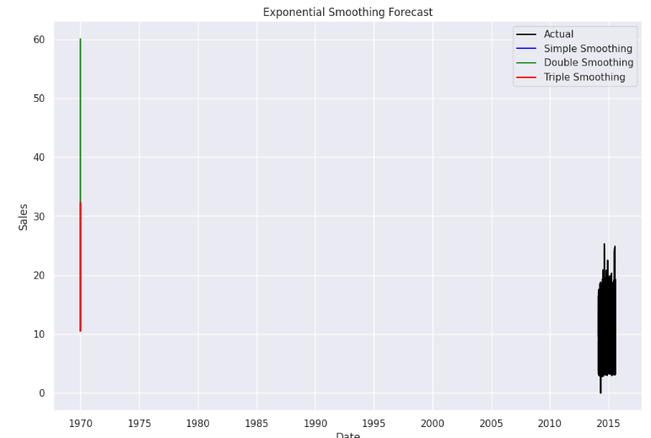
In exponential smoothing, the actual values tend to deviate from the predicted values.

Slide 42
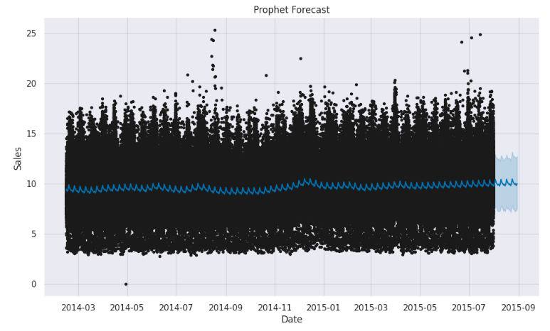
Prophet model

Slide 43

The training loss of 0.00057 and the validation loss of 0.00064, both sustained over 8 epochs, indicate a model that has achieved a high level of accuracy and generalization.
The training loss reflects how well the model is fitting the training data, and the validation loss gauges the model's performance on unseen data.

Slide 44

Seasonal Decomposition of Time Series

Slide 45

Sales Predicted for Test Data

Slide 46






Slide 47


Slide 48


Slide 49

Sales Prediction for next 6 Weeks

Slide 50
Thank You

